Slide 1

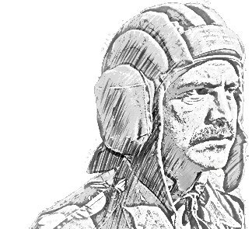

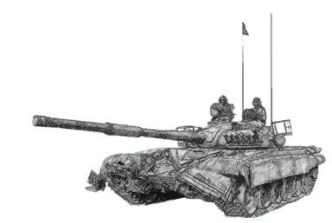
SCHOOL OF TECH TRG
ELECTRONICS WING

Slide 2
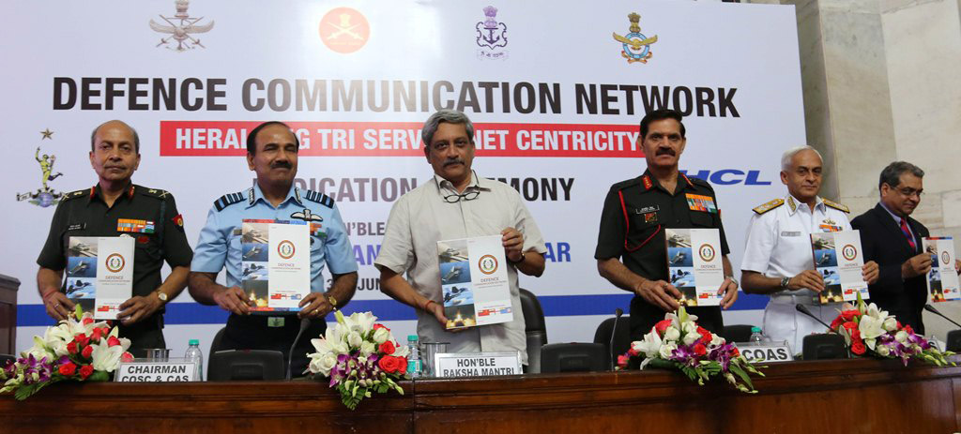
AIM
TO AQUAINT THE CLASS WITH DCN & NFS

Slide 3
PREVIEW
PART I : EXISITING COMN INFRA
PART II : DCN
PART III : NFS
PART IV : ADVANTAGES

Slide 4
PART I : EXISTING COMN INFRA

Slide 5


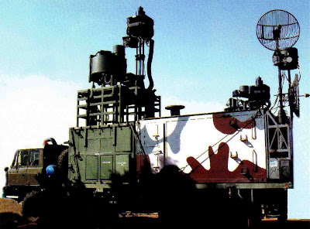
LIMITATION OF THE PRESENT TECHNOLOGY IN THE INDIAN ARMY
LIMITED DATA HANDLING CAPABILITY.
NON INTEGRATION WITH OTHER COMMUNICATION NETWORKS.
INABILITY OF TELE OR VIDEO CONFERENCING.
BULKY SYSTEM.
LIMITED RANGE (RLOS EQPT).
HIGH POWER CONSUMPTION.
CANNOT BE INTEGRATED WITH THE BMS AND FUTURE PROTOCOLS.
AREN

Slide 6

LIMITATION OF THE PRESENT TECHNOLOGY IN THE INDIAN ARMY
POOR RELIABILITY.
OBSOLETE EQUIPMENT
LOW DATA TRANSFER CAPABILITY
LACK OF LAST MILE NETWORK.
NON INTEGRATION WITH FUTURE TECHNOLOGIES.
ASCON

Slide 7

TACTICAL COMMUNICATION SYSTEM
THE TCS HAS TO PROVIDE
VOICE DATA AND VIDEO.
INTEROPERABILITY
HIGH DATA RATES
FLEXIBILITY
COMMUNICATION ON THE MOVE
NETWORKING
SECURITY
REDUCE THE LATENCY.
.
PROVIDES COMN THROUGH “COMMERCIAL MOBILE TECHNOLOGY” & “PHASED OUT”.

Slide 8
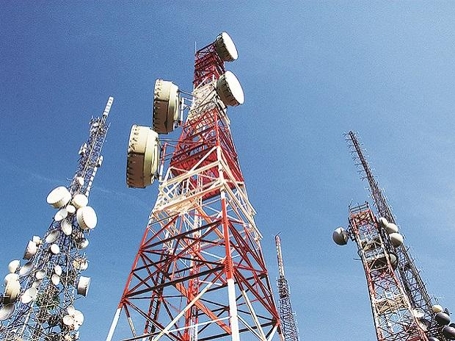
MOBILE CELLULAR COMMUNICATION SYSTEM
MCCS
STATIC DPLY : HIGH INITIAL SETUP COST AND HIGH POWER REQMT.
EXPENSIVE : LTD TO THREE CORPS ONLY
USE OF 2G TECH : CDMA (LTD BW)
LTD AVAILABILITY OF COMPATIBLE HANDSETS
( HTC & MOTOROLA)

Slide 9
NEED FOR A SECURE AND FAST COMMUNICATION MEANS
NEED OF DESIGNING A TCS
INCREASED CAPACITY
SECURE
JAMMING RESISTANT
LOW INTERCEPTION
ROBUST
FORCE MULTIPLIER

Slide 10
COMN WITH OTHER SERVICES
AFNET : IACCS
SAT COMN
INDIAN NAVY

Slide 11
PART II : DCN

Slide 12
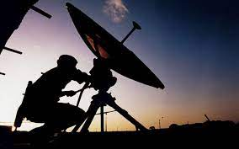

DCN

Slide 13
DEFENCE COMN NETWORK
MAKE IN INDIA
HCL & INFY
STARTEGIC LEVEL TRI SERVICES COMN NETWORK
LINKED WITH ALL HQ, MoD, IDS & OP FMNS
EXPECTED SERVICE DURATION : 30 YEARS
BASED ON OFC & SAT COMN
SERVICES : VOICE, VIDEO, DATA & VoIP
INFRA : 60000 KMS & 129, 162 & 33 STNS OF ARMY, NAVY & AIRFORCE

Slide 14
PART III : NFS

Slide 15
NETWORK FOR SPECTRUM
MAKE IN INDIA
BSNL, L&T, TATA, STERLITE, PUNJ LLYOD etc
TRI SERVICES OFC BACKBONE
HIGHLY RESILIENT NEXT GEN NETWORK
DEFENCE INTEREST ZONE UPTO 100 KMS FROM IB
INFRA : 60000 KMS & 129, 162 & 33 STNS OF ARMY, NAVY & AIRFORCE

Slide 16
PART IV : ADVANTAGES

Slide 17
ADVANTAGES : NFS
HIGHLY RESILIENT & RUGGES NWTWORK
HIGH DATA RATE
EASY MAINT
TERMINAL TILL FWD LOCS
ACCESS TO ALL APPLICATIONS DEVELOPED BY IA
HIGH SECURITY
MULTIPLE DATA TXN
ALL WX OP

Slide 18


